Slide 1
Paying for a Level 3 & above course and Advanced Learner Loans
Presentation for Applicants

Slide 2
Before we start… some basic information & advice
No-one has to get an Advanced Learner Loan!
If you are unsure about taking out a loan or you want to seek advice about options that might be open to you, contact The Money Advice Service. This is an organisation which has been established by the UK government and can offer you free, impartial money advice. Visit their website: https://www.moneyadviceservice.org.uk/en/articles/how-to-work-out-the-true-cost-of-borrowing
If you are unsure about your course choice, you can find information and advice from the National Careers Service on 0800 100 900 or on their website: https://nationalcareers.service.gov.uk/
Course advice is also available from the Student Experience Team in College. Contact us studentservices.email@boltoncc.ac.uk

Slide 3
If you do decide to apply for an Advanced Learner Loan…
It is essential that you visit the following website for more information and to make an application for the Advanced Learner Loan: https://www.gov.uk/advanced-learner-loan

Slide 4
Check you are eligible for an Advanced Learner Loan
Loan eligibility does not depend on your income and there are no credit checks
Checkout the above website to confirm that you qualify – your age and your nationality/ residency status (if you do not fit these criteria, please do not apply)
You must also have an offer of a place on a course which is eligible to be funded by an Advanced Learner Loan - this is part of your interview process with the Course Tutor at Bolton College

Slide 5
Before You Apply…
You will require all the essential documentation listed below to hand:
Your Learning and Funding Letter We will provide this to you once you have enrolled onto an eligible course. You will receive a copy by email, and another copy will be on your Learner Hub account in your Report History.
Your National Insurance Number
Your Proof of Identity - If you are a UK national, complete your UK passport details in your application as proof of identity If you do not have a UK passport (or it has expired), you will need to send your original birth or adoption certificate as proof of identity
If you’re from an EU country, send your EU passport or identity card the first time you apply. Use the ‘Evidence return form’ Advanced Learner Loan Evidence Return Form (publishing.service.gov.uk) if you need to send extra information to support your application, such as proof of residency status.
NB: The Student Loans Company do not accept driving licences, out of date passports or any other form of proof of ID.

Slide 6
How to Apply for an Advanced Learner Loan (pt 1)
Use: https://www.gov.uk/advanced-learner-loan/how-to-apply
You can apply online or download a paper copy of the application form.
When applying on line you will firstly have to create an account with the Student Loans Company (SLC)
To create an account - you will need an email account that you check regularly and your National Insurance Number

Slide 7
When you’ve clicked the apply online link, you’ll see this screen; if you don’t already have an account with the Student Loans Company, please select Create an account
How to Apply for an Advanced Learner Loan (pt 2)

Slide 8
How to Apply for an Advanced Learner Loan (pt 3)
When creating your account you will be asked for a password and a memorable answer to a security question – make a note of these and keep them in a safe place
When you have created your account you will be allocated a Customer Reference Number (CRN) which you also need to keep safely as you will need it whenever you deal with the SLC
The SLC will send a confirmation email confirming your CRN when your account has been set up

Slide 9
How to Apply for an Advanced Learner Loan (pt 4)
If the system says you already have an account, this may be because you have an account from the past when you have been on a previous FE or University course or if you have financially supported someone else at University. Check your past email accounts but you may need to ring SLC if you can’t remember your CRN and security details.
SLC Helpline: 0300 100 0619 (Monday to Friday 9.00 to 17.30)

Slide 10
When you have set up your Student Loan Account, you can then apply for a Loan; select the blue box as shown below:

Slide 11
As you will be taking a Further Education course which would be funded via an Advanced Learner Loan at the College, you need to click on the right hand box (below)

Slide 12
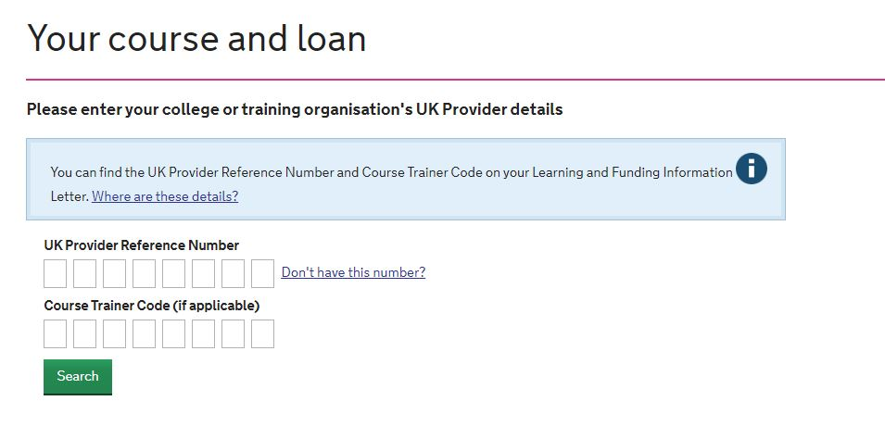
Your Course and Loan (pt 1)
The application is straightforward until you reach the parts below
You will need your Learning and Funding Letter to help you with this part of the application.
Enter the Provider code number into the boxes; please note that there is no Course Trainer Code for Bolton College. Click “search”

Slide 13
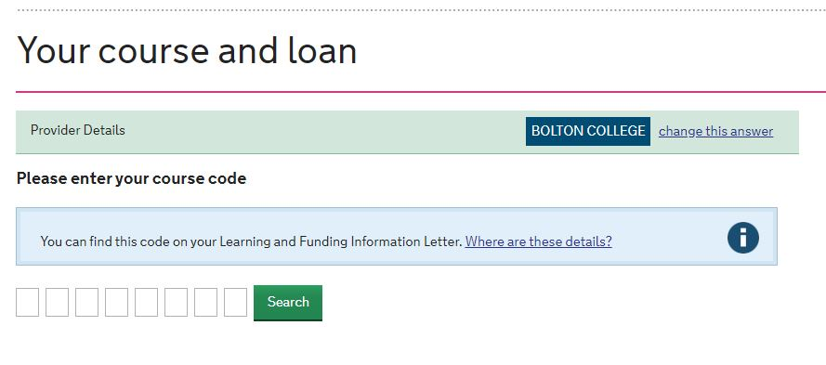
Your Course and Loan (pt 2)
Course Code – copy the course code from the Learning and Funding Letter into the boxes and search – this should then bring up the name of your course

Slide 14
Your Course and Loan (pt 3)
Course Start & End Date – copy these dates from the Learning and Funding Letter
Total College Fee – copy the fee for the course from the Learning and Funding Letter
Loan Required – you need to state how much you wish to borrow, this can be up to the full cost of the course. Please note that the minimum you can borrow is £300.
Remember: Interest will be added to the loan from the day you get it, so bear in mind that the amount you repay will be greater than the initial loan.
If you have problems with this section contact: studentservices.email@boltoncc.ac.uk

Slide 15
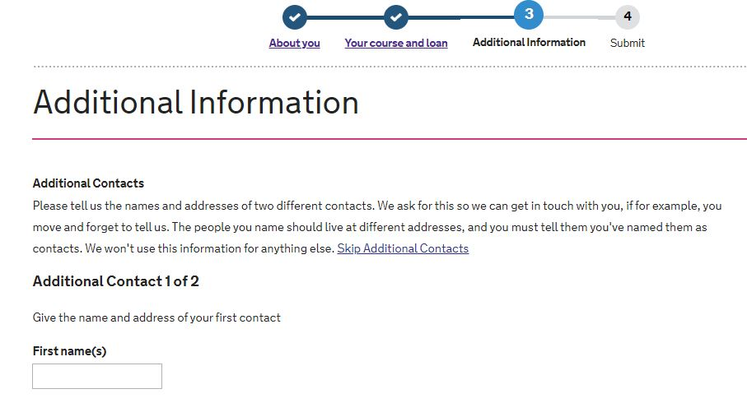
Additional Information
Please note you may skip the additional contacts if you are unable to provide this information.

Slide 16
Submitting your on-line application
Before you submit, you will need to confirm that you have read and agree to the Terms & Conditions of the Loan, and enter your password again to confirm you wish to apply.
This acts as an electronic signature, meaning you do not have to print off, sign and send to the SLC a hard copy of your declaration that you wish to apply for a Loan.

Slide 17
Submitting your paper application
At the end of the paper application you must read the Terms and Conditions and complete the declaration at the foot of the page with your full name, your signature and the date, before sending the application off to the address at the bottom of the form:
Advanced Learner Loans, PO Box 302, Darlington, DL1 9NQ

Slide 18
After Application…
Keep a watch on your emails for information from the SLC to see whether your Loan has been approved and whether they need anything else from you. You can also log onto your SLC account to see progress of your loan application.
The Advanced Learner Loan is paid directly to the College for your course fees once you start your course
You have a 10 day cooling off period from the day you start the course, to cancel your loan without any fees being charged to you but you need to inform the College and the SLC within this period if you feel you wish to leave the course
Once your application is approved, you may be entitled to assistance from the Advanced Learner Loan Bursary Fund in College. This is a means tested fund which supports students with travel expenses and childcare support. Contact: studentfinance@boltoncc.ac.uk

Slide 19
How will I pay back the Loan?
You don’t have to pay any of your loan back until you’ve started earning over £25,000 a year. Payments are taken from your wage automatically.
If you leave or change course after two weeks or more, you’ll have to pay back the Student Loans Company any money that was paid to the college. You will also be liable to pay the College the full cost of your course if you do not complete.
You can choose to pay off some or all of your loan at any time with no extra charge.
Any outstanding balance is automatically written off 30 years after your scheduled qualification end date.

