Slide 1
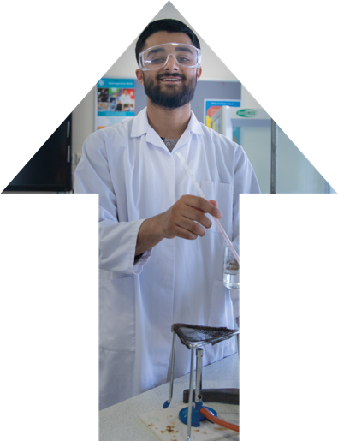









T LEVELS
WELCOME TO THE
NEXT LEVEL!
Bolton College delivering
T Levels from September 2021

Slide 2


T LEVELS
WELCOME TO THE
NEXT LEVEL!
CLICK HERE
Notes:
Image Page 204 – different image
- any young person
https://www.youtube.com/watch?v=XYQw5rQrwwA&feature=youtu.be

Slide 3
ABOUT T LEVELS
T Levels are a brand new, 2 year qualification
that will give you a head start towards
the future you want.
They bring classroom learning and an extended industry placement together on a programme
designed with employers and businesses.

Slide 4



‘Sainsbury Review’
The ‘Sainsbury Review’ of technical education recommended the development of new qualifications with the input of businesses, employers and industry experts.
On the back of the review, new T Level qualifications have been developed to provide young people with clear educational routes which lead to employment in specific occupations or progression opportunities to higher education.
Notes:
Ask Dave if he could replicate page 47 covering business

Slide 5
‘Sainsbury REVIEW’
T Levels will become one of the main choices for students after GCSE alongside:
- Vocational qualifications, including BTECs
- Apprenticeships for students who wish to learn a specific occupation ‘on the job’ whilst earning a wage
- A Levels for students who wish to continue academic education
Notes:
Ask Dave if he could replicate page 142 covering health & social

Slide 6
A NEW CHOICE!
T Levels are ideal if you have finished your GCSEs and want the knowledge and experience to get straight into employment, an Apprenticeship or higher education.
You’ll spend 80% of your time in the classroom and 20% on a minimum 315 hours placement with an employer, to give you the knowledge and skills companies look for.

Slide 7

T Levels - Developed with Employers and Businesses
There are new fast-developing technologies in all sectors of work – by creating qualifications with employers and businesses curriculum stays current with the latest industry requirements.
T Levels include:
- A technical qualification, which will include core theory, concepts and skills for an industry area - Specialist skills and knowledge for an occupation or career
- An industry placement with an employer
- A minimum standard in maths and English if
students have not already achieved them
Notes:
Use bigger version of image on page 187

Slide 8
Coming in 2021
T Levels take 2 years of full-time study and are equivalent to 3 A Levels.
We’re one of just 64 colleges nationally who, from 2021, have been given the green light to deliver the New Gold Standard T Level qualifications.

Slide 9
Your
Opportunity!
This is great news if you’re joining us in September 2020, as you’ll have the opportunity to progress on to T Level programmes in the areas of:

Slide 10


Construction
Design, Surveying & Planning Pathway
Onsite Construction Pathway
Notes:
Top image take from page 102 with lady surveyor
Bottom image take from page 74 bottom half

Slide 11
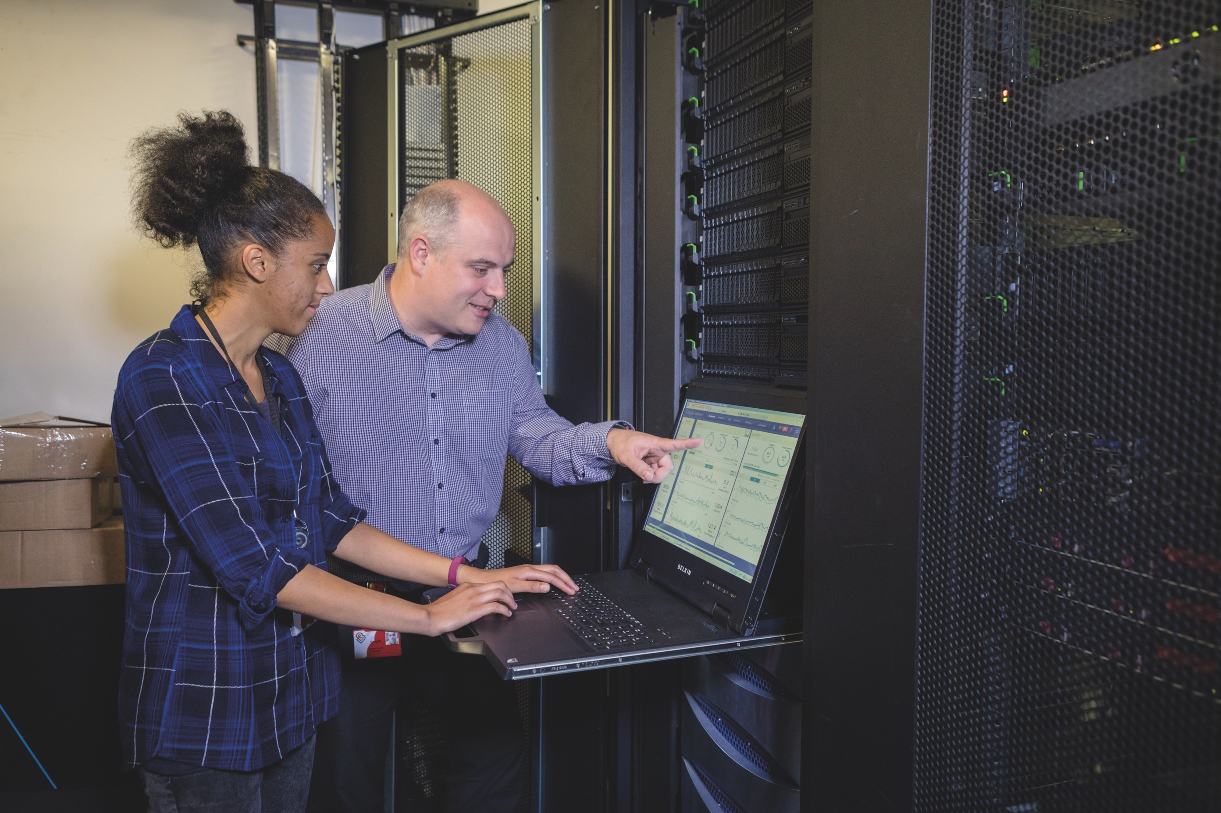
Digital
Digital Production, Design and Development Pathway
Notes:
Page 68 (colour out the badge

Slide 12

Education & Childcare
Education & Childcare Pathway
Notes:
Page 58

Slide 13
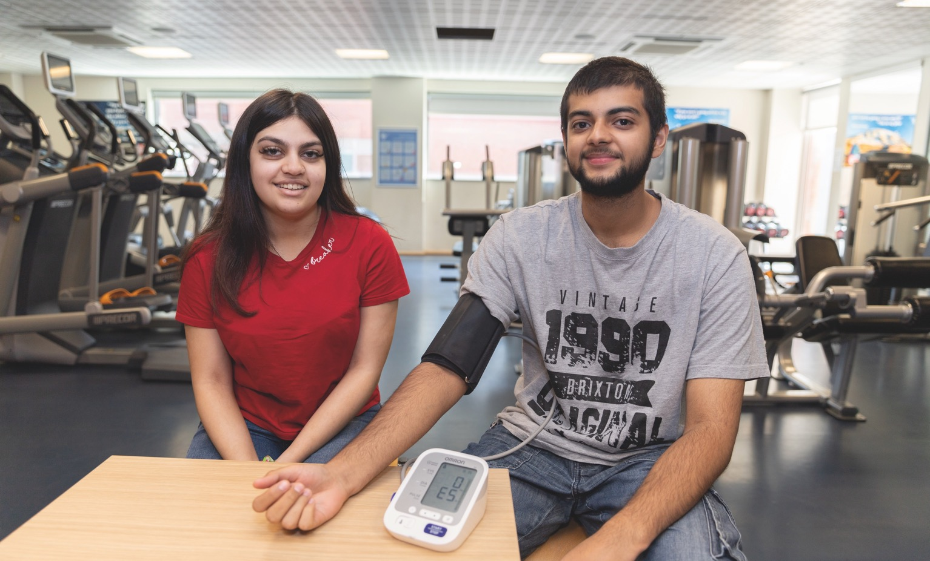

Health & Science
Health Pathway
Science Pathway
Notes:
Top page 146
Bottom image bottom of page 31

Slide 14
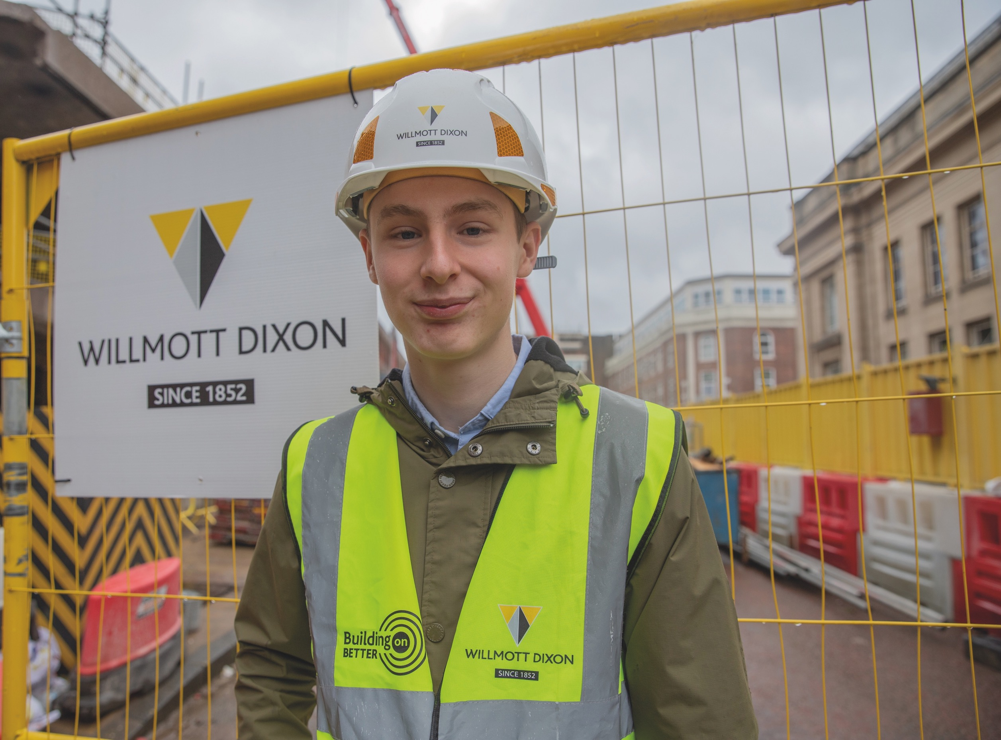
Construction - DESIGN, SURVEYING & PLANNING
Your course starts by helping you get to grips with core knowledge of how the construction industry works, the principles of design and the role of technology and sustainability. You will then have the chance to specialise in one of these areas:
- Building services design
- Civil engineering
- Hazardous materials analysis and surveying
- Surveying and design for construction and the
    built environment
Notes:
Page 105

Slide 15
Construction –
ONSITE CONSTRUCTION
Your course starts by helping you get to grips with core knowledge of how the construction industry works, the principles of design and the role of technology and sustainability. You will then have the chance to specialise in at least one of these areas:
- Bricklaying
- Carpentry & Joinery
- Painting & Decorating
- Plastering
Notes:
Dave again – all group image from page 72

Slide 16

DIGITAL PRODUCTION, DESIGN & DEVELOPMENT
Learn the essentials behind all digital roles by understanding data and digital systems, how software and business interact, security, testing, planning and legal issues.
You then build on this by developing specialist skills in understanding user needs and designing and developing digital systems.
Notes:
Need to search for something – young person ethnic linked to digital systems

Slide 17
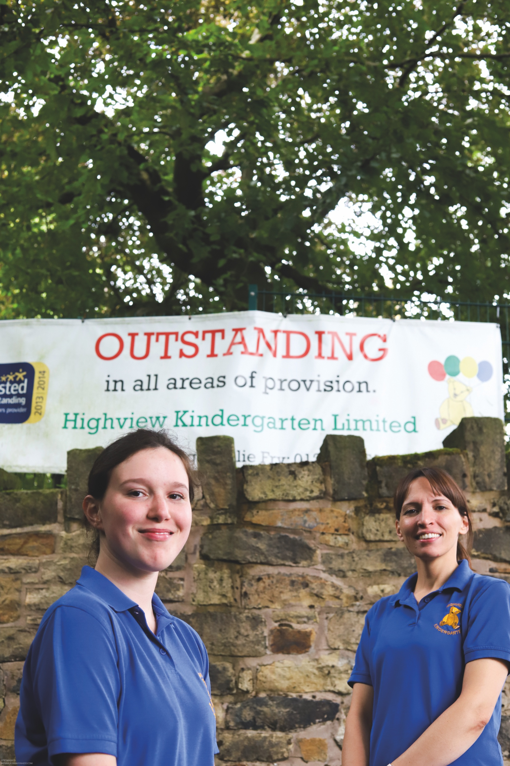
EDUCATION & Childcare
Everyone studies a core curriculum of child development, how education works plus important topics like safeguarding and special educational needs. You can then focus on one of these areas:
- Early Years Education and Childcare
- Assisting Teaching
Supporting and Mentoring Students Further and Higher Education
Notes:
Page 61

Slide 18
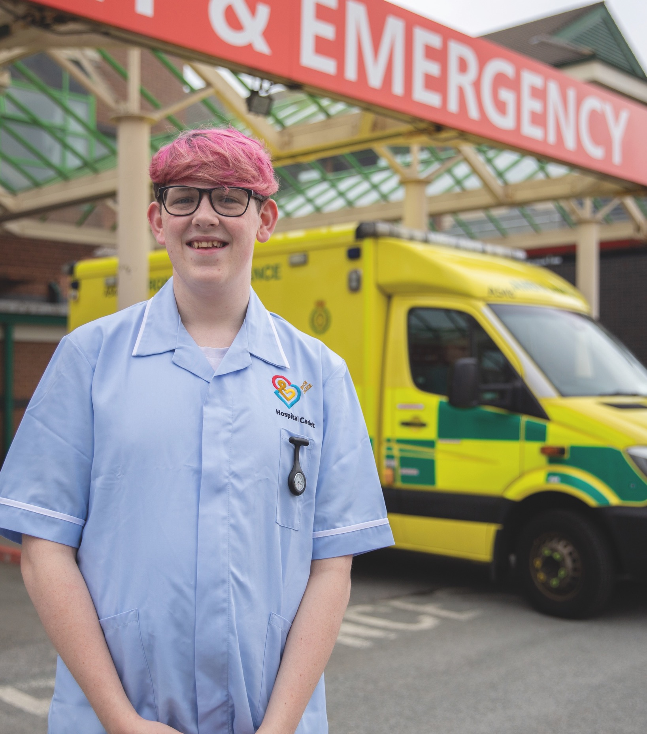
health & Science - HEALTH
You’ll learn the essential knowledge and skills needed to work in health or science including how the industry works, core scientific concepts and key regulations including managing information, health and safety and good practice.
You can specialise in dental nursing or supporting healthcare. If you choose supporting healthcare, you will focus on at least one of these areas:
- Adult Nursing Care
- Care Of Children and Young People
- Mental Health
- Midwifery
- Therapy
Notes:
Page 144

Slide 19
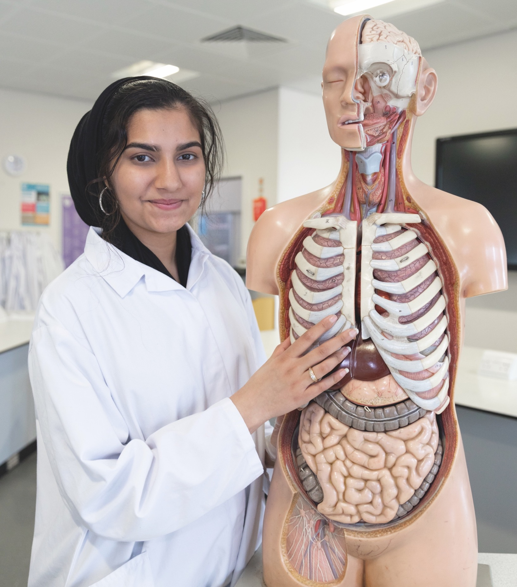
health & Science - SCIENCE
Your course starts with the essential knowledge and skills to work in science or healthcare including how the industry works, core scientific concepts and key regulations including managing information, health and safety and good scientific/clinical practice.
You will then have the chance to specialise in at least one of the following areas:
- Animal Sciences
- Food Sciences
- Laboratory Services
- Metrology (Measurement) Sciences
Notes:
Page 30

Slide 20
Why choose a
T Level?
T Levels are a new choice after your GCSEs. Check out the five great reasons for choosing a T Level – and get ready to move to the Next Level!

Slide 21
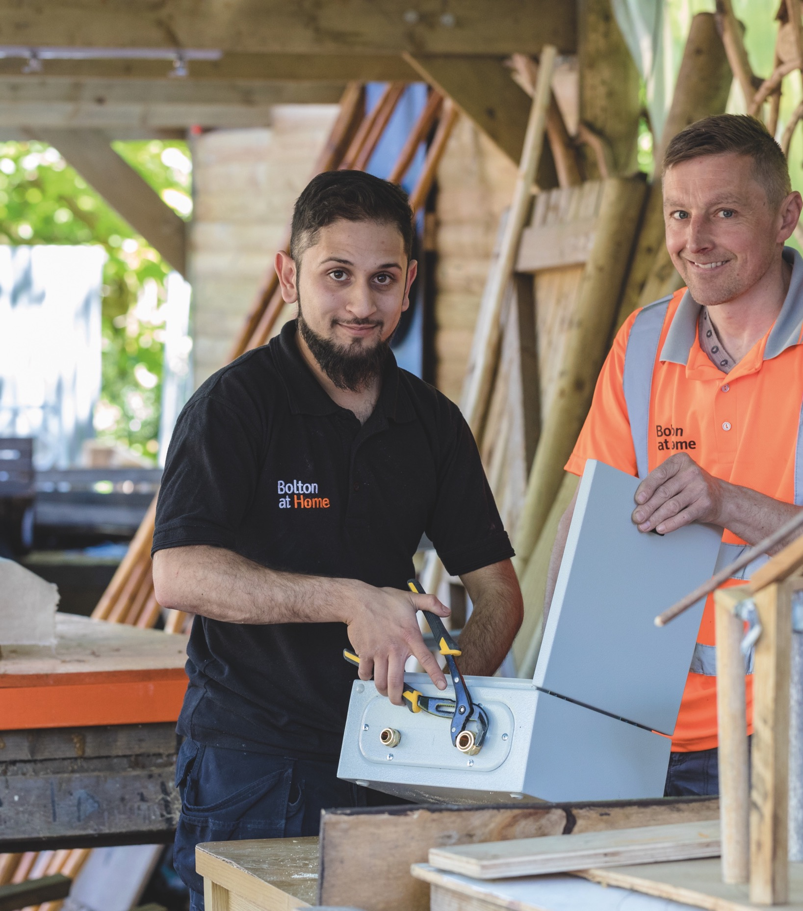
Why choose a
T Level?
Created with business
T Levels have been designed with leading businesses and employers to give you the knowledge and skills you need.
More than 200 businesses – including Fujitsu and IBM – have been involved, so you can be confident your T Level will move you to the Next Level!
Notes:
Bottom image page 20

Slide 22

Why choose a
T Level?
Learn your way
T Levels involve more classroom study than Apprenticeships, which means you can experience an industry whilst you continue your studies.
Notes:
Page 48

Slide 23

Why choose a
T Level?
Qualifications That Count
When you pass your T Level, you will get a nationally recognised certificate showing the overall grade you achieved - pass, merit, distinction or distinction*.
It will also give details of what you learned on the course, to help you move into skilled employment or a Higher Apprenticeship.
Notes:
Library and LRC image page 199 young man leaning over computer

Slide 24

Why choose a
T Level?
Recognised by UCAS
Your T Level will be worth UCAS points – a T Level Distinction* is worth the same as 3 A Levels at A* – and will be recognised by universities and employers, so you can choose to continue studying if you wish.
Notes:
Middle page 197 HE lady

Slide 25
Why choose a T Level?
Recognised by UCAS
UCAS Tariff Points | T Level Overall Grade | A Level
168 | Distinction* (A* on the core and distinction in the occupational specialism) | AAA*
144 | Distinction | AAA
120 | Merit | BBB
96 | Pass (C or above on the core) | CCC
72 | Pass (D or E on the core) | DDD

Slide 26



Why choose a
T Level?
Get ahead in your career
T Levels give you the chance to learn what a real career is like while you continue your studies.
Your industry placement will last for at least 45 days – when and how you complete it depends on the T Level, college and employer.
Notes:
Picture in the big arrow on page 27 (Dave)

Slide 27



Industry Placements –
What students say…
CLICK HERE
Notes:
Page 22 if you can get the student and sign in

Slide 28

Not sure you’re ready for T Levels?
Don’t worry…the College will be delivering T Level Transition Programmes for individuals who:
Are able to demonstrate an aptitude and keenness to progress onto studying a T Level
Need further support to address barriers to accessing a T Level
Would benefit from the additional time to build their knowledge and skills in English and Maths
Learn better in a classroom/workshop base environment rather than the workplace
Notes:
Top of page 31

Slide 29
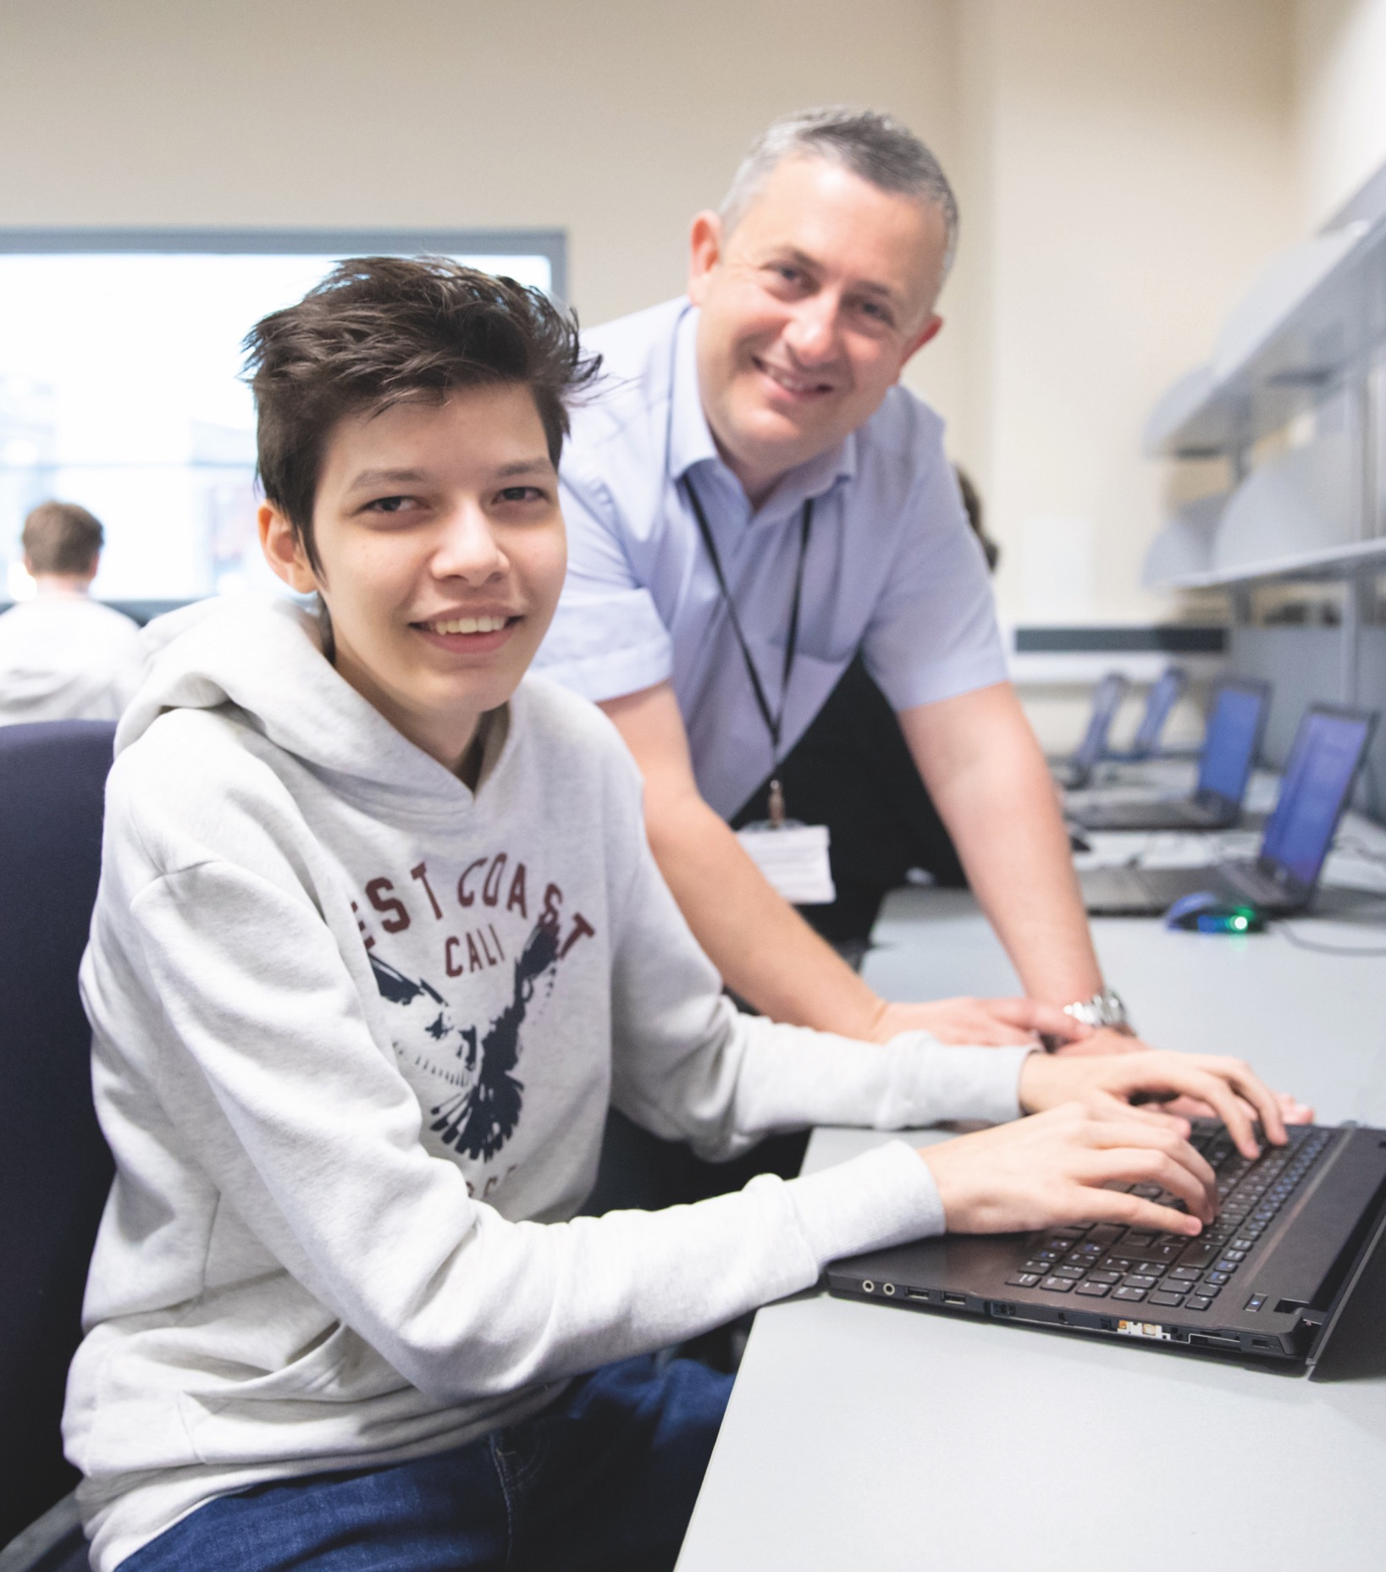
Not sure you’re ready for T Levels?
T Level Transition Programmes are made up of 5 key elements:
Assessment and guidance period – assess learners’ capabilities and support needs
English, maths and digital skills
Work experience – to build the skills, behaviours, attitude and confidence
Technical skills - introductory skills and concepts to prepare students for the chosen T Level route
- Support & personal development
Notes:
Page 67

Slide 30

Progression Pathways
Transition Programme Progression
If you successfully complete a Transition Programme you can then apply for entry to a T Level programme; the College will then assess your suitability for progression to T Levels.
T Level Programme Progression
When you complete a T Level study programme, students will be able to choose between moving into a skilled occupation or further study, for example, a higher level Apprenticeship, or higher level technical study, including higher education.
Notes:
Page 87 lady painting

Slide 31

Grading & Certification
You will get a nationally recognised certificate which will show the overall grade and a breakdown of what you have achieved.
The T Level certificate will include:
- An overall grade for the T Level, shown as ,,, pass, merit, distinction or distinction*
- A separate grade for the core component, ….using A* to E
- A separate grade for each occupational ….specialism, shown as pass, merit or distinction
Notes:
Top of 197

Slide 32

Grading & Certification
It will also include confirmation that you have:
- Met the minimum requirements for maths and English qualifications
- Completed the industry placement
- Met any additional mandatory requirements
Your overall T Level grade will be worked out from the grades you achieved on the core component and the occupational specialism(s).
Notes:
Page 50

Slide 33
Any Questions?

