Slide 1
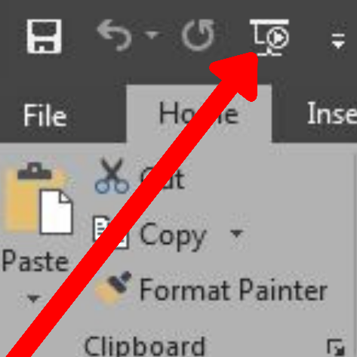
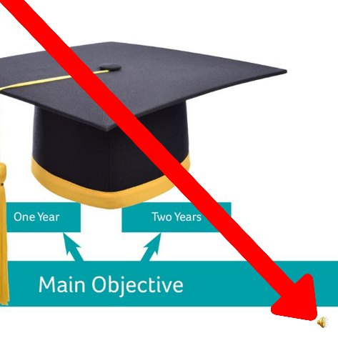
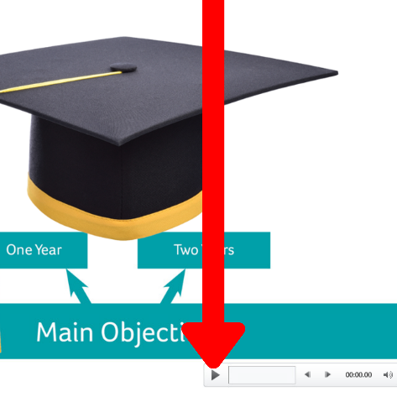
To listen to the narrative for this Access presentation, please do the following:
Press F5 or click this button at the top left-hand corner of your screen.
The presentation should play automatically, without the need to click on individual slides.
If you prefer to manually play the presentation, this is also possible. Each time you click onto a slide, hover your mouse pointer over the speaker logo, on the bottom right of each individual slide:
Next, click play on the pop-up bar that appears.
Do this with each slide.

Slide 3
How to prepare for Access to HE
Systems to support your success
What happens next

Slide 6
1

Slide 7
This course is 12 hours per week, with at least that much time again in personal study time.
Do you have effective support networks around you to enable you to succeed?

Slide 11
Notes:
Under science and humanities take out the last bullet point as this is one course

Slide 13
Personal tutor for your specific pathway
Study-skills sessions to prepare you for university
Lunchtime drop-in sessions by English specialist for Access learners
The Hub: College-wide drop in sessions for English and maths
Workshops and drop-in sessions for UCAS applications

Slide 15
Notes:
Take out bullet points 3,4 and 5 . Also remove the character and information on the right hand side
Add the following link and text under the bullet points
For the latest information on Advanced learner loans please visit:
www.gov.uk/advanced-learner-loan

Slide 16
Notes:
Remove the line at the bottom of the slide - not relevant anymore

Slide 17
Notes:
Is this the latest version of the University logo?

Slide 19
Notes:
Add courses from slide 10 but just the science and humanities courses

Slide 20
Notes:
Add courses from slide 10 but just the science and humanities courses

